Slide 1


Slide 2

Windows programming
Graphics APIs
OpenGL Programming in Visual C++
GLUT
OpenGL Overview
Appendix

Slide 3

Prepare Your Development Environment
To write a Windows program in C or C++, you must install the Windows SDK or a development environment that includes the Windows SDK, such as Microsoft Visual C++.

Slide 4

Microsoft Foundation Classes
C++ wrappers to the Windows SDK
An application framework
A useful set of extensions
MFC
SDK
Windows

Slide 5

Microsoft Foundation Class Library
  A set of wrapper classes of win32 API to better support windows programming
  What’s the benefit and how it looks?
    A windows program with win32 API (win32)
    A windows program with MFC

Slide 6

WinMain
  Declare a window and set properties
  Register the window
  Create the window and show
  Listen to user and dispatch messages to WinProc
WinProc
  Message loop routine
  Wait for user messages and act as set by programmer

Slide 7

Every Windows program includes an entry-point function that is named either WinMain or wWinMain.
Here is an empty WinMain function.
INT WinMain(HINSTANCE hInstance, HINSTANCE hPrevInstance, PSTR lpCmdLine, INT nCmdShow)
{
return 0;
}

Slide 8

WM_CREATE, WM_DESTROY, WM_CLOSE, WM_QUIT
WM_MOVE, WM_SIZE
WM_SETTEXT, WM_GETTEXT
WM_PAINT
WM_KEYDOWN, WM_KEYUP
WM_MOUSEMOVE, WM_LBUTTONDOWN, WM_LBUTTONUP, WM_RBUTTONDOWN, WM_RBUTTONUP, WM_MOUSEWHEEL
A full list

Slide 9

afx_msg void OnLButtonDown(UINT nFlags, CPoint point); //added to header file
ON_WM_LBUTTONDOWN() //added to message map at top of cpp file
void CCssample1View::OnLButtonDown(UINT nFlags, CPoint point) {
  //code to be exectud when Lbutton is pressed down
}

Slide 10

simpleMFC
  CWinApp:CWinThread:CCmdTarget:CObject
  Define the application: CsimpleMFCApp
  Declare the message map: DECLARE_MESSAGE_MAP
MainFrm
  CMainFrame:CFrameWnd:CWnd:CCmdTarget:CObject
  Define the main window

Slide 11

simpleMFCDoc
  CDocument:CCmdTarget:Cobject
  Encapsulate the application data
simpleMFCView
  Cview:CWnd:CCmdTarget:Cobject
  Encapsulate the data views and interactions with user

Slide 12

Create a new SDI project
Add member variables to CsketchGDIview
  CDC* pDC
  CPoint m_pt
  Cpoint m_ptold
  bool m_drawenabled

Slide 13
Add event handlers
  Open property page of CSketchGDIView class and add handlers for
    WM_LBUTTONDOWN
    WM_LBUTTONUP
    WM_MOUSEMOVE
  In OnLButtonDown
    m_drawenabled = true; //enable drawing mode
    m_ptold = point; //save the current point

Slide 14

  In OnLButtonUp
    m_drawenabled = false; //quit drawing mode
  In OnMouseMove
    If in drawing mode, start drawing, else quit
    m_pt = point; //save the current point
    pDC = GetDC(); //get the device context
    m_color = RGB(rand(), rand(), rand()); //generate a color
    CPen newPen(PS_SOLID, 1, m_color);//create a pen
    pDC->MoveTo(m_ptold);
    pDC->LineTo(m_pt); // draw a line from m_ptold to m_pt
    m_ptold = m_pt; //update the old point for next drawing

Slide 15

http://msdn.microsoft.com/en-us/library/ws8s10w4.aspx

Slide 16

Provide a software interface to graphics hardware (an intermediary between an application program and the graphics hardware)
Increase software portability
Reduce the development time
Example: OpenGL, DirectX

Slide 17

2D/3D graphics API
Most widely used/supported by industry
Runs on Unix, Linux, Window, etc.
C, C++, Java, etc.
Hardware independent
Easy to render objects

Slide 18


Download the GLUT library.
Copy the glut32.dll and paste it in C:\Windows\System32 folder.
copy glut.h file and paste it in C:\Program Files\Microsoft Visual Studio\VC\include folder
copy glut32.lib and paste it in c:\Program Files\Microsoft Visual Studio\VC\lib folder.

Slide 19
Now you can create visual c++ console application project and include glut.h header file then you can write code for GLUT project. If you are using 64 bit windows machine then path and glut library may be different but process is similar.

Slide 20

Include files:
  #include <gl/gl.h>
  #include <gl/glu.h>
Library files need linked to:
  opengl32.lib, glu32.lib
Device context (Drawing to window)
  HDC hDC = GetDC(hWnd)
  ReleaseDC(hWnd, hDC)

Slide 21
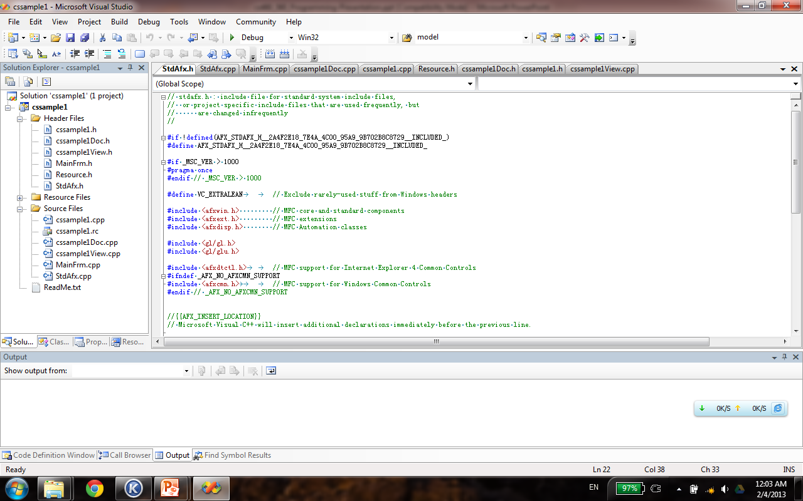


Slide 22
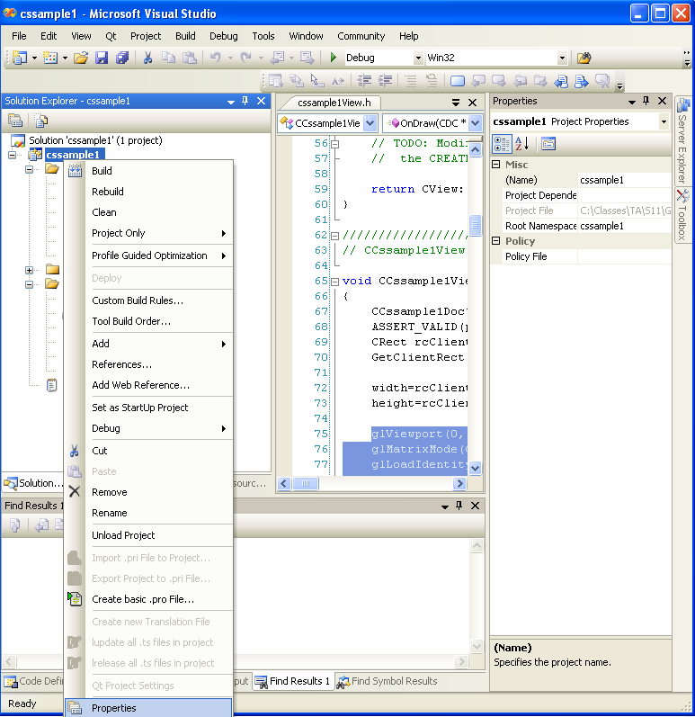

Slide 23
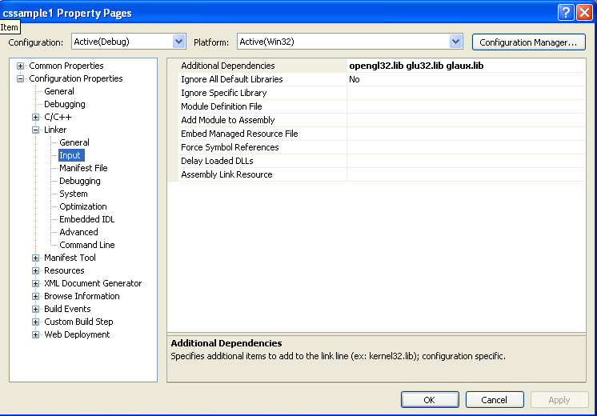

Slide 24

Pseudocode
- Initialize variables, memory space
- Create & show window, update window for client area updating
Loop
Fetch any message sent from Windows to this program
If message is QUIT
Terminate program, return control to Windows
If any other messages
Do corresponding actions depending on the message ID and parameters
Return control to Windows
End Loop

Slide 25
Need to set pixel format (tells system how we are going to use the DC)
  PIXELFORMATDESCRIPTOR pfd;
  SetPixelFormat(…);
Render context
  HGLRC hRC; //handle
  hRC = wglCreateContext(hDC); //get context
  wglDeleteContext(hRC); //free up context

Slide 26

GLUT is a window system independent toolkit for writing OpenGL programs. It implements a simple windowing application programming interface (API) for OpenGL. GLUT makes it considerably easier to learn about and explore OpenGL programming. GLUT provides a portable API so you can write a single OpenGL program that works across all PC and workstation OS platforms.

Slide 27
GLUT is designed for constructing small to medium sized OpenGL programs. While GLUT is well-suited to learning OpenGL and developing simple OpenGL applications, GLUT is not a full-featured toolkit so large applications requiring sophisticated user interfaces are better off using native window system toolkits. GLUT is simple, easy, and small.

Slide 28
Advantage:
  Simplify opening window, I/O, etc.
    glutInit(…);
    glutCreateWindow(…);
    glutDisplayFun(display);
    glutMainLoop();
    glutSwapBuffers();

Slide 29
Low-level graphics library specification
Programmer has access to primitives
  Lines
  Points
  Polygons
Can specify objects in 2D and 3D
Using the primitives with certain commands, we control how object is rendered

Slide 30
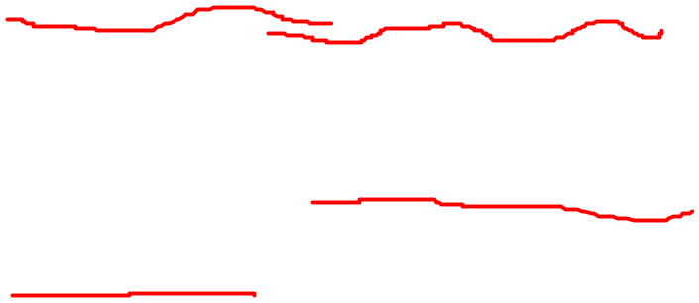
Sample syntax
glBegin(GL_POINTS);
for(i=1 to size of data)
glVertex3d(x, y, z);
glEnd();
Primitives:
  GL_LINE
  GL_POINTS
  GL_LINE_LOOP

Slide 31

SetPixel(hDC,x,y,col);
MoveToEx(hDC, x, y, NULL);
LineTo(hDC, x, y);
Polygon(hDC, lppts, num_points)
Polyline(hDC, lppts, num_points)
glBegin(GL_POINTS);
glBegin(GL_LINES);
glBegin(GL_POLYGON)
glBegin(GL_LINE_LOOP)
Windows
OpenGL

Slide 32

Attributes (State variables)
  Property of primitives (color, line style, etc.)
    glColor3f(R, G, B);
Transformations (Matrix math)
  Setting View ports, object rotation, translation, etc.
    glLoadMatrix(..);
    glRotatef(..);
    glTranslatef(..);
Execution
  glFlush(); //needed to make sure commands //are executed

Slide 33

Change state
  glEnable();
  glDisable();
Drawing in 3D
  Hidden surface removal
    Depth buffer and depth testing
      glEnable(GL_DEPTH_TEST);
    Culling the object (remove polygons)
      glEnable(GL_CULL_FACE);
      glCullFace(GL_BACK);

Slide 34

Viewing
  View transform analogous to camera positioning
  Model transform analogous to positioning model
Viewing transforms must precede model
  glViewport(..);
  glMatrixMode(GL_PROJECTION);
  glLoadIdentity();
  glOrtho(..);
  glMatrixMode(GL_MODELVIEW);
  glLoadIdentity();
  //translate, scale, rotate object…

Slide 35

I/O – GLUT handles this (mouse, key, etc..)
Initialize graphics system
  auxInitWindow();
  glutCreateWindow();
Store/read pixels
  glReadPixels();
  glCopyPixels();
Photorealism
  glLightf();
  glShadeModel();

Slide 36
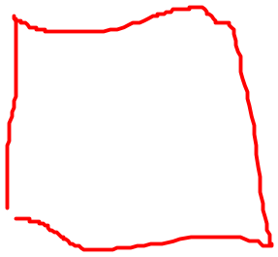
Texture mapping
//Initialization
glTexParameteri(GL_TEXTURE_2D, GL_TEXTURE_WRAP_S, GL_REPEAT);
glTexParameteri(GL_TEXTURE_2D, GL_TEXTURE_WRAP_T, GL_REPEAT);
glTexParameteri(GL_TEXTURE_2D, GL_TEXTURE_MAG_FILTER, GL_LINEAR);
glTexParameteri(GL_TEXTURE_2D, GL_TEXTURE_MIN_FILTER, GL_LINEAR);
glBindTexture(GL_TEXTURE_2D, texName[1]);
gluBuild2DMipmaps( GL_TEXTURE_2D, 3, BMBACK.bmWidth, BMBACK.bmHeight,
GL_BGR_EXT, GL_UNSIGNED_BYTE, BMBACK.bmBits );
glTexImage2D(….., bmBits);
//Texture mapping
glBindTexture(GL_TEXTURE_2D, texName[1]);
glTexCoord2f(0,0);
glVertex3f(-BM.bmWidth,0,0);
glTexCoord2f(0,1);
glVertex3f(-BM.bmWidth,BM.bmHeight,0);
glTexCoord2f(1,1);
glVertex3f(0,BM.bmHeight,0);
glTexCoord2f(1,0);
glVertex3f(0,0,0);
glEnd();

Slide 37
Order of operations
  Construct shapes from primitives
  Arrange objects in 3d space, select view
  Calculate color of object(s)
  Convert mathematical description of object(s) to screen (rasterization)

Slide 38
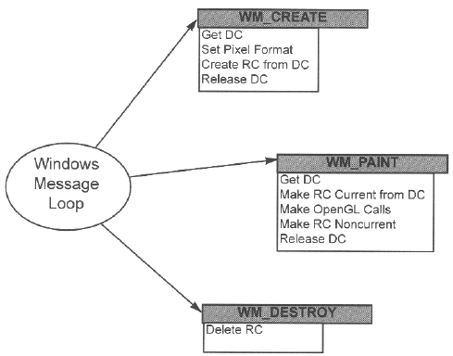
This picture borrowed from prof. Eckert’s course slides

Slide 39
You may find a lot of useful materials and tutorial on youtube and opengl “redbook”
You could also come to my office hour

Slide 40

Visual Studio MFC Programming
  File->New-> MFC AppWizard (exe) -> SDI (MDI)
  MFC Document/View structure
CDocument
CView
Screen
Printer
Serialize &
deserialize
Data
  Events Driven and Messages Delivery (WM_Create, WM_Size, WM_LMouseDown etc)
  Device Context and Device Independence
  Same program use different hardware by letting windows take care of hardware interface
Program draws on an abstract surface called a “device context” (DC)
DC is accessed with a “handle to a DC”, which can be get from windows by using GetDC( )
DC need to be released after have finished using it by ReleaseDC( )

Slide 41

Use OpenGL in MFC Programming
Structure of a typical OpenGL program
Create application window (GetSafeHwnd())
Get proper Device Context (m_hDC= GetDC())
Set pixel format for windows (SetWindowPixelFormat(m_hDC))
Create the OpenGL view context (CreateViewGLContext(m_hDC))
Response to Messages, complete required tasks and clear resources
▪ We need to create a new OpenGL rendering context that is suitable for drawing on the device referenced by device context. The rendering context has the same pixel format as the device context
Implementation, a small code example:
HDC hdc; HGLRC hglrc;
hglrc=wglCreateContext(hdc); //create rendering context
wglMakeCurrent(hdc, hglrc); //make it the current rendering context
//call OpenGL APIs to fulfill your task ……
//when the rendering context is no longer needed
wglMakeCurrent(NULL, NULL); //make the rendering context not current
wglDeleteContext(hglrc); //delete the rendering context

Slide 42
Application Window Initialization
Get handle of window
OnCreate( )
Get handle of Device Context
OnSize( )
Waiting for Messages and response to them
Set Pixel Format
OnDraw( )
Create and make current rendering context
OnMouseMove()
Make rendering context not current and delete it
OnLMouseDown()
………
OnDestroy( )
Release resources and close app window

Slide 43

Some Concepts of OpenGL
Double Buffer, use for no flickering animation
Color Buffer, use glClear(GL_COLOR_BUFFER_BIT) to enable
PIXELFORMATDESCRIPTOR structure describes the pixel format of a drawing surface
SetPixelFormat(…) is use to sets the pixel format of the specified device context to the format specified by the iPixelFormat index
BOOL SetPixelFormat(
HDC hdc, //device context whose pixel format the function attempts to set
int iPixelFormat, //pixel format index (one-based)
CONST PIXELFORMATDESCRIPTOR * ppfd
//pointer to logical pixel format specification
);

Slide 44
Code Example (from MSDN):
PIXELFORMATDESCRIPTOR pfd = {
sizeof(PIXELFORMATDESCRIPTOR), // size of this pfd
1, // version number
PFD_DRAW_TO_WINDOW | // support window
PFD_SUPPORT_OPENGL | // support OpenGL
PFD_DOUBLEBUFFER, // double buffered
PFD_TYPE_RGBA, // RGBA type
24, // 24-bit color depth
0, 0, 0, 0, 0, 0, // color bits ignored
0, // no alpha buffer
0, // shift bit ignored
0, // no accumulation buffer
0, 0, 0, 0, // accumulate bits ignored
32, // 32-bit z-buffer
0, // no stencil buffer
0, // no auxiliary buffer
PFD_MAIN_PLANE, // main layer
0, // reserved
0, 0, 0 // layer masks ignored
};
HDC hdc;
int iPixelFormat; // get the best available match of pixel format for the device context
iPixelFormat = ChoosePixelFormat(hdc, &pfd);// make that the pixel format of the device context
SetPixelFormat(hdc, iPixelFormat, &pfd);

Slide 45

OpenGL Functions Use to Create a view window with a 2D orthogonal view:
glViewport(0, 0, width, height);
glMatrixMode(GL_PROJECTION);
//current matrix specifies projection transformation, subsequent calls affect the projection matrix
glLoadIdentity();
//clear current matrix by loading with identity matrix
gluOrtho2D(0.0, width, 0.0, height);
glMatrixMode(GL_MODELVIEW);
//succeeding transformations affect the modelview matrix now
glLoadIdentity();

Slide 46
OpenGL drawing primitives, Code Example:
glColor4f(1.0, 1.0, 1.0, 0.0);
glPushMatrix();
glBegin(GL_LINE_LOOP);
glVertex3d(x1, y1, 0);
glVertex3d(x2, y2, 0);
glVertex3d(x3, y3, 0);
glEnd();
glFlush();
glPopMatrix();
This code draws three lines to form a triangle. If we use glBegin(GL_TRIANGLES) we will get a filled triangle.

